Slide 1
Special Ed Reporting 101
An Introduction to Special Education Data Reporting
Greg Hess / Candice Schuld
Notes:
This was originally presented by Jodi Rissinger at the 2015 PDE Data Summit. The presentation was developed in coordination with Crystal Jenkins, Jodi Rissinger, Cindy Gavazzi, and Greg Hess. Updates made by Greg Hess and Candice Schuld.
This is mainly an overview for those who are new to Special Education reporting.

Slide 2
Why is the data collected?
Federal IDEA funding
State Performance Plan
Annual Performance Report
Special Education Data Report Targets
Compliance Monitoring
Corrective Action and LEA Determinations
Accountability

Slide 3
State Performance Plan
Indicator 1 | Graduation rates
Indicator 2 | Dropout rates
Indicator 3 | Student participation and performance on statewide assessments (PSSA/PASA)
Indicator 4 | Suspension and expulsion rates
Indicator 5 | Educational placement (Least Restrictive Environment, or LRE)
Indicator 8 | School facilitated parent involvement
Indicator 9 | Disproportionate representation by race/ethnicity
Indicator 10 | Disproportionate representation by race/ethnicity in disability categories
Indicator 11 | Timelines for initial evaluation
Indicator 13 | Postsecondary transition goals and services
Indicator 14 | Postsecondary outcomes
Available at http://penndata.hbg.psu.edu/
Notes:
Not to be confused with School Performance Profile (SPP)
Available at: http://penndata.hbg.psu.edu/

Slide 4
Notes:
An example of the State Performance Plan.

Slide 5
Data Sources
Main Source - IEP, ER, NOREP (Teachers, Directors, Psychologist)
Staff (Tables 1-3) -Human Resources/Business Dept.
Table 8A – Initial Evaluation Report (ER)
Discipline Table 9A & 13 - Principals/Safe Schools
Table 13 Children Subject to Expulsion - includes all students in grades K-12 (including regular education students)

Slide 6
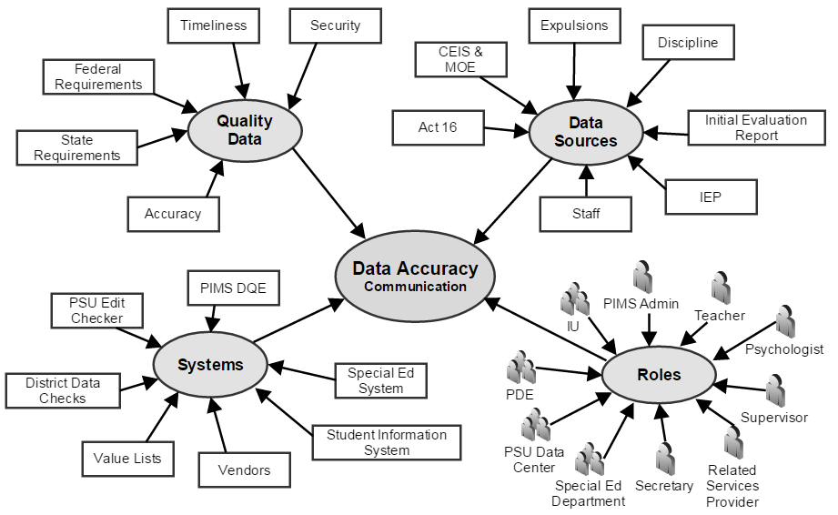
Notes:
Communication is key to bringing all the parts together.

Slide 7
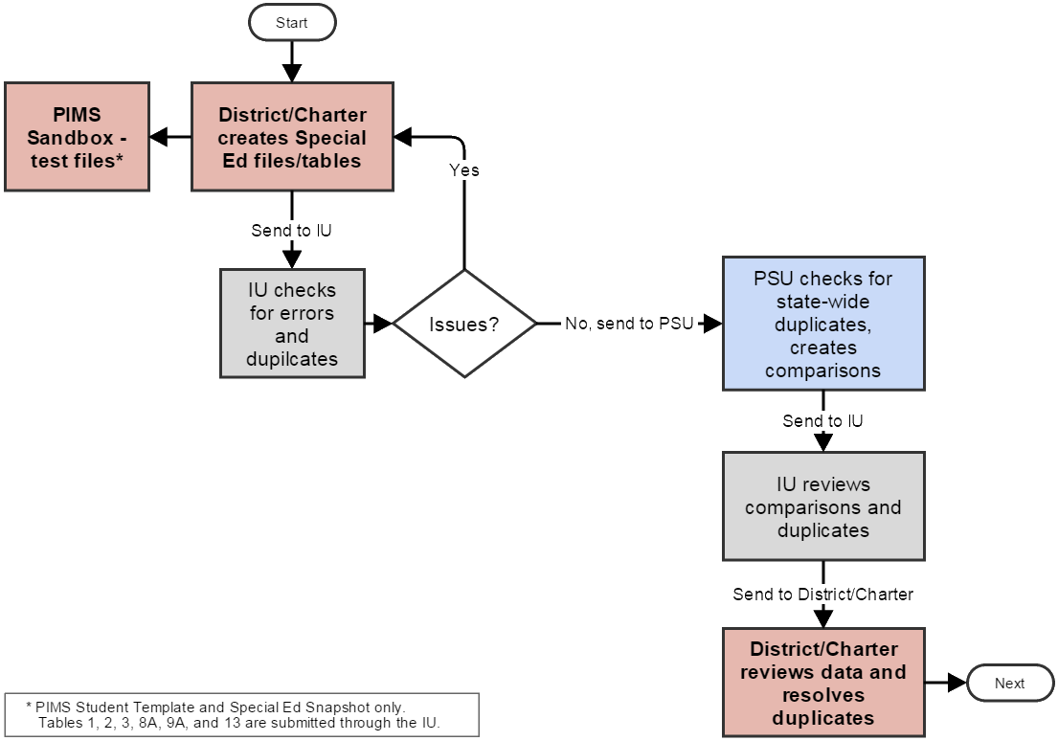
Submission Process

Slide 8
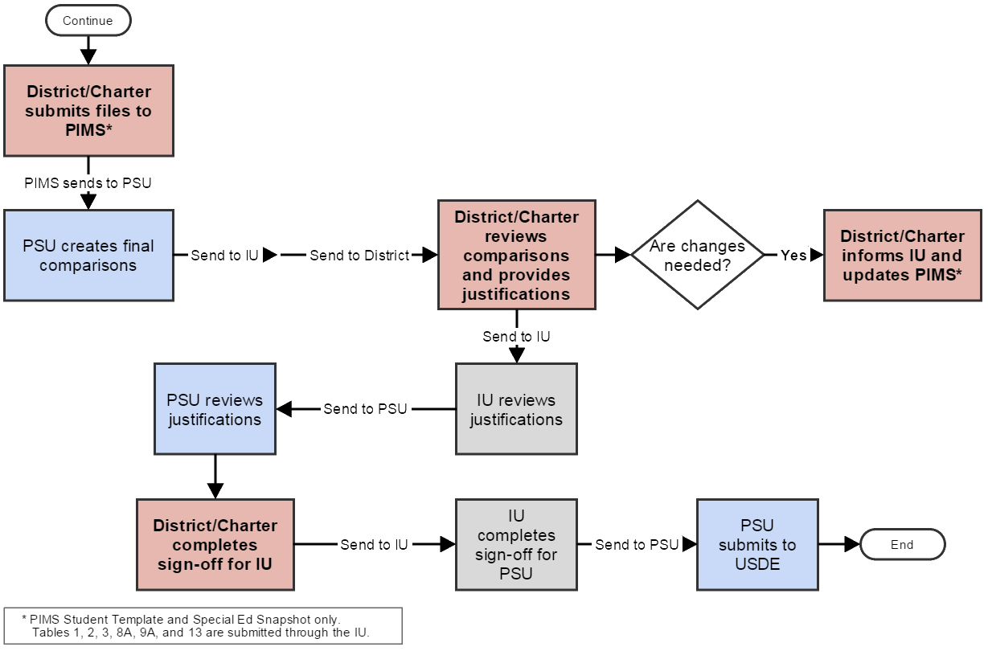
Submission Process

Slide 9
What are Comparison Reports?
Data submitted this year compared to last year’s data.
Review detail information with your Special Ed data team. Last chance to make adjustments!
Who is my Special Ed data team??
Provide Justification:
Was there an increase in a particular population within the LEA? Why?
Was there a change in personnel or programming that caused a particular category to increase? What?
Was there a change in policies or procedures that caused a change in reporting categories? What?
Small N size

Slide 10
Who Submits Special Ed data?
School District of Residence
Who Else Submits:
Charter School
Foster Parent Home District (1305)
School District Where County Prison Is Located
Who Does Not Submit:
IU – Intermediate Unit
Educating School District (if different that the Resident School District)
APS – Approved Private School
County Prison
CTC – Career Technology Center
PRRI – Private Residential Rehabilitation Institution
SJCI – State Juvenile Correction Institution
You Do Not Submit These Students:
Students educated in state adult and state juvenile correctional facilities. (These are reported by PA Department of Corrections Education)
Notes:
Who submits what students may differ from the rest of the PIMS submissions.

Slide 11
Best Practices
Accuracy starts with student enrollment
Check/Analyze data monthly
Sync SIS and Special Ed systems
Keep data current in systems – IEP, ER, RR, exit data, discipline data, staff
Plan timelines so IEPs are not due at the end of November
Being cognizant of submission timelines when exiting students from services

Slide 12
Submission Timelines
Oct – Act 16 (for the previous SY)
Dec – Child Count, Table 14
July – Staff, Exits, Discipline
July/Quarterly - Table 8A
Data validation timelines defined locally by IU
Notes:
Staff as of 12/1

Slide 13
December vs. July Submissions
December Child Count
Active Students with a valid IEP on December 1
PIMS Special Ed Snapshot
PIMS Student Template
July Child Count
Only Students exiting Special Ed during school year (7/1 - 6/30)
PIMS Special Ed Snapshot
PIMS Student Template
Supplemental Tables
Staff (Tables 1 – 3) as of 12/1
Initial Evals (Table 8A)*
Discipline (Table 9A)
Expulsions (Table 13)
Regular and Special Ed
* On cyclical monitoring year.

Slide 14
July - Special Considerations
Data as of last day enrolled
Students moving within PA – not submitted
Reached Maximum Age vs. Graduated
“Super Seniors”
Summer Grads after 7/1
Graduation Code: S
Enrollment record: not required
Summer Grads before 6/30
Graduation Code G
Enrollment record: not required
Notes:
Exit reasons: Graduated, GED, Max Age, Dropped Out, Transferred to Regular Ed, Moved out of PA, Died.
Moved within PA is the only exit reason not submitted.
Reached Maximum Age (met goals) vs. Graduated vs. Reached Maximum age (did not meet goals)

Slide 15
Special Ed Data Submission Scenarios
Scenario 1
Case: Student is receiving his/her services from the District of Residence or Charter School
Student Template > Field 217 District of Enrollment: District of Residence AUN/Charter School’s AUN
Student Template > Field 167 Special Ed Referral: N
Enrollment record required? Yes
Special Ed Snapshot > Field 70 Service Provider: District of Residence AUN/Charter School’s AUN
Special Ed Snapshot > Field 71 Location of Special Ed Services: 4 digit location code of building where they are receiving the services

Slide 16
Special Ed Data Submission Scenarios
Scenario 2
Case: Student is receiving his/her services at a PIMS reporting agency (another SD, CS, CTC, IU, APS, PRRI, SJCI)
Student Template > Field 217 District of Enrollment: AUN of the PIMS reporting agency providing the services
Student Template > Field 167 Special Ed Referral: Y
Enrollment record required? No (Service provider facility/educating LEA will be reporting their enrollment.)
Special Ed Snapshot > Field 70 Service Provider: AUN of the PIMS reporting agency providing the services
Special Ed Snapshot > Field 71 Location of Special Ed Services: 4 digit location code of the building where the student is receiving the services. If the building does not have a 4 digit location code, list the name of the building (IU programs) OR if PRRI or APS use 0000.

Slide 17
Special Ed Data Submission Scenarios
Scenario 3
Case: Student is receiving his/her services at a NON-PIMS reporting agency
Student Template > Field 217 District of Enrollment: District of Residence AUN
Student Template > Field 167 Special Ed Referral: N
Enrollment record required? Yes (District of Residence/Charter School must submit the enrollment record since the service provider will not be submitting to PIMS)
Special Ed Snapshot > Field 70 Service Provider: AUN of service provider facility (if they have one). If they don’t have an AUN, you will submit the name of the facility.
Special Ed Snapshot > Field 71 Location of Special Ed Services: 4 digit location code of the building where the student is receiving the services. If the building does not have a 4 digit location code, list the name of the building
Examples of these type of facilities:
05-Public Separate Facilities (Res) 16-Other Private Separate Facilities (Non- Res)
06-Other Private Separate Facilities (Res) 18-County run Correctional Facilities
12-Public Separate Facilities (Non- Res)

Slide 18
PIMS Student Template
Field | Description | Location
10 | Current Grade Level | From data in SIS or Special Ed system (not on IEP)
14 | Birth Date | From data in SIS or Special Ed system (not on IEP)
15 | Gender | From data in SIS or Special Ed system (not on IEP)
16-20 | Address | From data in SIS or Special Ed system (not on IEP)
27 | Race/Ethnicity Code | From data in SIS or Special Ed system (not on IEP)
34 | Challenge Type | From data in SIS or Special Ed system (not on IEP)
38 | Special Education | From data in SIS or Special Ed system (not on IEP)
41 | LEP Participation | From data in SIS or Special Ed system (not on IEP)
126 | Name Suffix | From data in SIS or Special Ed system (not on IEP)
133 | Last Name | From data in SIS or Special Ed system (not on IEP)
134 | First Name | From data in SIS or Special Ed system (not on IEP)
142 | Middle Name | From data in SIS or Special Ed system (not on IEP)
Current Grade Level
Birth Date
Gender
Address
Race/Ethnicity Code
Challenge Type
Special Education (38)
LEP Participation
Name (First, Last, Suffix, Middle)

Slide 19
PIMS Special Ed Snapshot
Field | Description | Location
1 | District Code | From data in SIS or Special Ed system (not on IEP)
2 | Location Code | From data in SIS or Special Ed system (not on IEP)
5 | Student ID | From data in SIS or Special Ed system (not on IEP)
10 | Special Ed Teacher | IEP Team/Signatures-Special Ed Teacher
11 | Primary Disability | From the ER/RR and data in SIS or Special Ed system (not on IEP)
12 | Secondary Disability | From the ER/RR and data in SIS or Special Ed system (not on IEP)

Slide 20
PIMS Special Ed Snapshot
Field | Description | Location
15 | Amount of Special Ed Services | VIII-Education Placement – B – 1 – Amount of Special Ed Services
17 | Type of Support | VIII-Education Placement – B – 2 – Type of Support
34 | Date Exited Special Ed | NOREP – Derived from data in NOREP recommended placement (possibly in #7 Anticipated Duration)
44 | Educational Environment | VIII Penn Data – Section A – Percentage Category OR Section B-location type selected
49 | Educational Environment % | VIII Penn Data – Section A – Indicate Percentage column OR if Section B is filled out: Zero or Blank
52 | Reason for Exiting Special Ed | (NOREP-#1 Type of action taken)
70 | Service Provider | From data in SIS or Special Ed system (not on IEP)-AUN/Name of facility providing service
71 | Location of Special Ed Service | VIII-Education Placement – C – Name of School building where IEP will be implemented

Slide 21
Staff Tables (as of 12/1)
Table 1
Special Ed Teachers and Paraprofessionals providing services to children with disabilities, Ages 3-5
Highly Qualified / Not Highly Qualified
Table 2
Special Ed Teachers and Paraprofessionals providing services to children with disabilities, Ages 6-21
Highly Qualified / Not Highly Qualified
Table 3
Personnel providing related services for children with disabilities, Ages 3-21
Fully Certified / Not Fully Certified

Slide 22
Discipline Tables
Table 9A
Reported by student
Unilateral Removal by School Personnel
For Drugs, Weapons, Serious Bodily Injury
Unilateral Removal by Hearing Officer
Out of School Suspensions
In School Suspensions

Slide 23
Expulsion Table
Table 13
Expulsions for Special Ed and Regular Ed
Receiving educational services
Not Receiving educational services

Slide 24
Resources
Intermediate Units
PIMS Manuals:
www.education.pa.gov/Teachers - Administrators/PIMS/Pages/default.aspx
Volume 1 - Domains
Volume 2 - Appendix (where you will find specific codes)
PennData Website:
Contains: Special Education Resource Guide/July Submission Guide/State Performance Plan/Table 8A Template
http://penndata.hbg.psu.edu/
Penn Data Managers: http://penndata.hbg.psu.edu/IUList.aspx
Edna Website:
http://www.edna.ed.state.pa.us/Screens/wfSearchEntity.aspx
Notes:
IU personnel will work with school districts and charter schools to ensure accurate and timely submissions.
Please contact your local IU with any questions or concerns.

