Slide 1
December 1
This is a Test!
It’s About Your Data
Barry Frye
Manager of Student Data Information Systems
Appalachia Intermediate Unit 08

Slide 2
AGENDA
Peas in a Pod
Items That Caused Mild Consternation
Process Overview
Three Ws and One H
Spot Checker Results
Quiz
Special Education Exits

Slide 3


Vilfredo Pareto
Pareto Principle (80-20 Rule)
Special Education December 1 Submission
11 Fields out of 75 Causing Problems ≈ 15 %

Slide 4

WHAT CAUSED YOU ANGST?

Slide 5



Process Overview
LEA File Submission – (Dec 1 CHILD COUNT) $$$$$$$$$
PIMS Special Education Snapshot
PIMS Student
PIMS
PIMS Sandbox
IU
Error Checking
Bureau of Special Education
PDE Spot Checker

Slide 6
Before we look at individual fields that cause us problems:
Who – What – When – How

Slide 7


WHO IS SUBMITTED?
All special education students with a valid IEP as of 12/1 of the current school year.
Student Template must have
Field 34 Challenge Type
Field 38 (SPECIAL EDUCATION) should be populated with Y – has IEP.
What if the student returned to regular education on December 2?

Slide 8
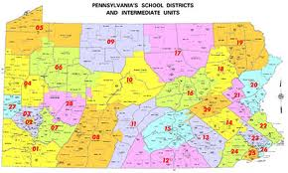
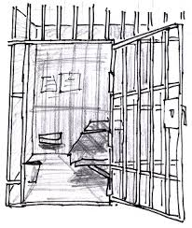
WHO SUBMITS?
School District of Residence
Who Else Submits:
Charter School
Foster Parent Home District (1305)
School District Where County Prison Is Located
Ward Of State Students

Slide 9
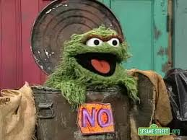
Who Does Not Submit
IU, Educating LEA (if different than Resident LEA), APS, County Prison, CTC
You Do Not Submit These Students:
Students educated in state adult and state juvenile correctional facilities.
Why? These are reported by PA Department of Corrections Education

Slide 10

What Is Submitted?
Student Demographic Data
Name, address, gender, race, LEP, student status, etc.
Student Location Information
School district, building
Student Challenge/Disability Information
Disability
Type of Support
Service Provider
Service Provider Location

Slide 11
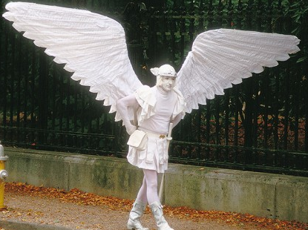
What Else Is Submitted?
Student Educational Environment
PLEASE DO NOT ‘WING IT’ !!!
Go to the SOURCE.

Slide 12
IEP (ANNOTATED page 46 April 2014)
VIII. PENNDATA REPORTING: Educational Environment (Complete either Section A or B; Select only one Educational Environment) pg 46
SECTION A: For Students Educated in Regular School Buildings with Non Disabled Peers – Indicate the Percentage of time INSIDE the regular classroom for this student:
SECTION B: This section required only for Students Educated OUTSIDE Regular School Buildings for more than 50% of the day – select and indicate the Name of School or Facility on the line corresponding with the appropriate selection: (If a student spends less than 50% of the day in one of these locations, the IEP team must do the calculation in Section A) www.pattan.net (search for annotated IEP)

Slide 13
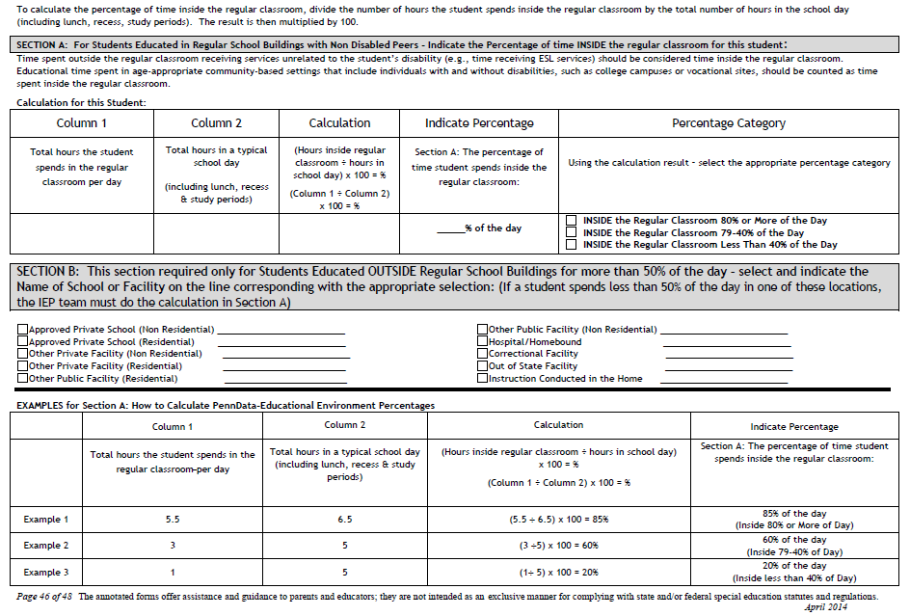

Slide 14
Student Educational Environment
If you have questions, please talk to your Special Education Personnel
Where are they being educated?
APS, PRRI, public residential/non-residential, etc
Are they being educated with non-disabled students?
THIS IS EXTREMELY IMPORTANT!
(IEP Section A)
If so, what is the percentage?

Slide 15

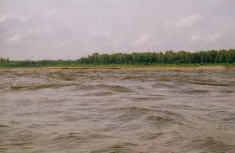
Special Education and Child Accounting Reporting
Do Not Over-Think This:
    (because Special Education is “SPECIAL”)
    Do not confuse Special Education reporting rules with Child Accounting reporting rules.
      Know the differences!

Slide 16
WHEN IS IT SUBMITTED?
December Special Education submission
PIMS Collection Window 2 for 2016-2017
Collection: Dec 1 - Dec 14
Review : Dec 15 – Jan 3
Correction: Jan 4 – Jan 31
(see Collection Calendar on the PIMS Education Portal)
What happens if you do not successfully submit records during the collection period?
Your preliminary Comparison Report WILL HAVE ALL ZEROS for this year!
And… Naughty.JPG

Slide 17


HOW IS IT SUBMITTED?
PIMS:
Student Template*
Special Education Snapshot Template
* For PIMS, may or may not be required
Why?
Prior to submitting to PIMS, what should you send to your IU for Spot Checker verification?

Slide 18
Comparison Report Process
How does the Comparison Report Process work?
PIMS Collection Window 2 for 2016-2017
Collection: Dec 1 - Dec 14
Review : Dec 15 – Jan 3
Receive Prelim Comparison Report
~Start of Review Period
Identify corrections
Correction: Jan 4 – Jan 31
Make corrections
Where are the corrections made?__________
Who submits the corrections?_____________

Slide 19

Spot Checker Results
Use the Process of Elimination
Copy of Spot Checker Log.xlsx

Slide 20

QUIZ

Slide 21
DON’T FORGET
JULY SPECIAL EDUCATION
WHEN IS IT SUBMITTED?
PIMS Collection Window 4 for 2016-2017
Collection: June 15 – July 21 PIMS Maintenance.JPG
Review : July 22 – July 29
Correction: August 1 – August 15
(see Collection Calendar on the PIMS Education Portal)

Slide 22
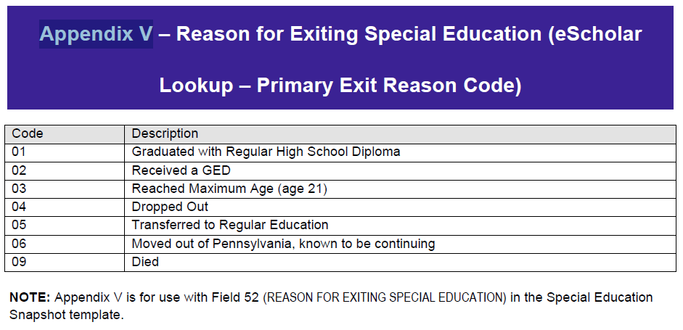
DON’T FORGET
JULY SPECIAL EDUCATION
(cont.)
WHO IS SUBMITTED?

Slide 23
JULY SPECIAL EDUCATION (cont.)
1. Do you report a student who remains in special education and transfers to a neighboring Pennsylvania school district? _____
2. You have a student who turns 21 during this current school year and graduates with a regular high school diploma.
What code do you report?____________
3. Can you ‘bank’ a diploma?___________

Slide 24
Barry Frye
Manager of Student Data Information Systems
Appalachia Intermediate Unit 08
4500 Sixth Avenue
Altoona, PA 16602
814-940-0223 (ext 1345)
bfrye@iu08.org
http://www.iu08.org

